Slide 1
Open Source Software Engineering
SE ZG587
Kumar Manish
29 July, 2023

Slide 2
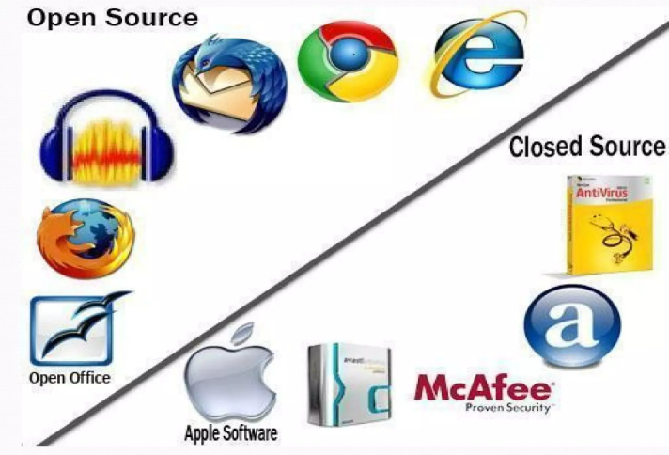


Recap : Session 1
Open source : What and Why
Open source Initiatives and examples
Proprietary Software and examples
Advantages and Disadvantages of Open source software

Slide 3
Session 2 : Agenda
Understanding of Open Source Software
Principle of Open Source software
Cost of Open Source Software
History of Open Source Software
Other software :
  Understanding of Free Software
  Understanding of Freeware
  Understanding of Public domain software

Slide 4

Understanding of Open Source Software
Definition : Open source software (OSS) is a software in which
  Source code is released under licenses, and
  The owner of the software (or copyright holder) permits the users the rights to use , modify and distribute the software to anyone and for any purpose
Philosophy : Development methodology – open collaboration Model
Rules : Governed by rules of Open source Initiative - open source Definitions (OSD) https://opensource.org/osd)
Charge : Available free of charge, in most cases . But in principle , it need not necessarily be free of cost.
Copyright : Yes
Examples :

Slide 5
Principle of Open Source software
Openness :
Publishing the design and source code of a software to public - with intent that
    Openly fixed or contributed to
    Openly scrutinised / criticized
    Open feedback obtained
    Analysed for bugs or defects
    Analysed for quality

Slide 6
Principle of Open Source software..
Transparency :
Ability of the community to see the current progress and future plans :
    projects roadmap is made available to the community
    A defects tracking system is put in place - for reporting and reviewing defects
    Publish design documents
To make more effective decision and understand how decision affects us.
Collaboration : everyone free to participate, enhance each others work in unanticipated ways to unlock new possibilities

Slide 7
Principle of Open Source software..
Release Early and Often : Rapid prototypes and iterative approach
Any changes proposed or made by any one are made public immediately.
Contributions are expected to occur early – resolve errors early in development Lifecyle
Contributions are expected to occur Often - changes shared with others immediately / regularly
Expectations of Community : Participants in an open source projects have expectations of a community - to be formed – that works together - to contribute to the development of the projects

Slide 8
Open Source Software – Open collaborations
The Main Principle behind software development model are :
  Decentralised Software Development
  Open collaboration, and
  Peer Production
As per Wikipedia
Open collaboration is “a System of innovation or Production or Development that relies on goal-oriented, yet loosely coordinated, participants who interact to create a product (or service ) of economic value, and make it available to contributors and non contributors alike”.

Slide 9
Rules for Distributions of open source Software
Free Redistributions
Source code
Derived works
Preserving Integrity of Original software
No discriminations based on Person or groups
No discrimination based on Field of Endeavours
Distribution of license
License should not be product specific
License Must not restrict other

Slide 10
Open Source Software – License
License must not restrict other software :
No restrictions should be placed on the license for the other software that would be distributed along with the licensed software .
For example : the license must not insist that all other programs distributed along with this software and through the same channel, should also be open-source
License must be Technology neutral :
License should not be grouped based on any specific technology or interface style

Slide 11
Open Source Software – Licenses
Open source Licenses examples :
  Apache Licenses 2.0 (Apache 2.0)
  3 clause BSD licenses (BSD -3 clause)
  2 clause BSD licenses (BSD 2-clasue )
  GNU General Public Licenses (GPL)
  GNU Lesser General public License (LGPL)
  MIT License (MIT)
  Mozilla Public License 2.0 (MPL 2.0)
  Eclipse Public License 2.0 (EPL 2.0)

Slide 12
Cost of Open source Software
Although OSS is free , there are some hidden cost :
Total cost of Ownership (TCO)
  Cost associated with adopting and managing the software
  Access to software updates, support services
Switching cost :
  Migrating data from older systems
  Training cost to Resources / users etc
Additional Cost :
  POC/ POV : Evaluation and Selection
  Integration cost
  Fixing critical bugs

Slide 13
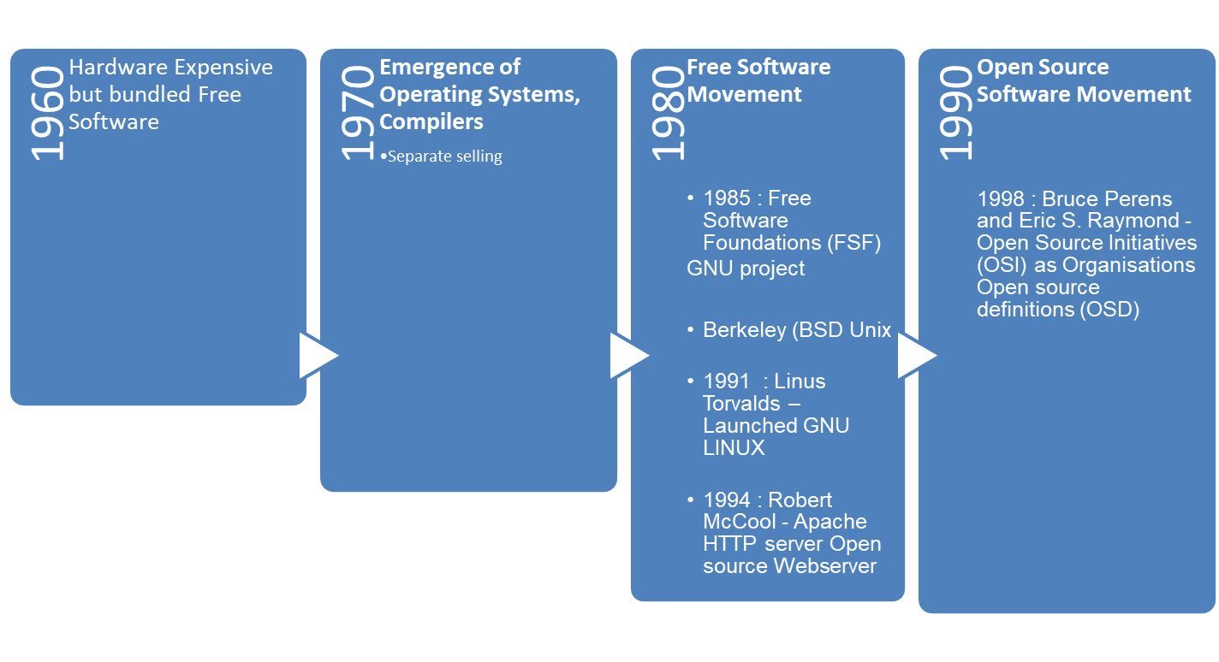
History of Open Source Software

Slide 14
Understanding of Free Software

Slide 15
Free Software
Free software” means software that respects users' freedom and community. It refers to free use of software and not price
Definition : Free software is the software that can be used , modified, studied, copied, changed and redistribute (with or without modifications) with no restrictions.
Philosophy : Social Movement
Charge : Free software is available free of charge , in the most cases , But , in principle, free software need not necessarily be free of cost;
  Free software does not mean non commercial
  One always has freedom to change or copy free software and then sell it.
  You may even sell the original software
Copyright : Yes
Examples :

Slide 16

Free Software – Social Movement
The free software movement is a Social Movement
  With the aim of gaining and assuring certain freedoms for software users
  Movement was Founded by Richard Stallman , in 1983, by launching GNU Project
  In 1985 established The Free software Foundations
Four essential Freedoms of free software
  Software which meets these freedom requirements is termed free software
“The Free Software Foundation (FSF) is a nonprofit with a worldwide mission to promote computer user freedom. We defend the rights of all software users.”

Slide 17
Free software – Four essential freedoms
A program is “free software” if its users have the following :
  Freedom 0 : The freedom to run the program as you wish, for an purpose
  Freedom 1 : The freedom to study how the program works , and change it as per your requirements
  Freedom 2 : The freedom to redistribute copies so you can help others
  Freedom 3 : The freedom to distribute copies of your modified versions to others
    Pre-requisite “ Access of the source code”

Slide 18
Free Software - Legal considerations
Legal considerations :
  The owner of the free software does not have power to withdraw or invalidate the license , or add additional restrictions to its terms and conditions,
The license terms should be permanent and irrevocable

Slide 19
Free Software - Licenses
A large number of licenses qualify as free software licenses
and are fee compatible with GNU General Public licenses :
Examples :
  GNU General Public License (GPL) version 3
  GNU General Public Licenses (GPL) version 2
  GNU All – Permissive License
  Apache License version 2.0
  Clarified Artistic License
Refer a complete list of licenses at :
https: // www.gnu.org/licenses/license-list.html

Slide 20


GNU in a Nutshell
GNU was launched by Richard Stallman, as an operating system which would be put together by people working together for the freedom of all software users to control their computing.
The name of the system, GNU, is a recursive acronym meaning GNU's Not Unix—a way of paying tribute to the technical ideas of Unix, while at the same time saying that GNU is something different.
Technically, GNU is like Unix. But unlike Unix, GNU gives its users freedom.

Slide 21
References and further readings
Open Source Initiative https://opensource.org/
Open Source Resources https://opensource.com/
Open Source Guides (https://opensource.guide/
Working with GitHub for Open Source Software Development (https://github.com/) How To Pronounce GNU - GNU Project - Free Software Foundation
GNU in a Nutshell - GNU Project - Free Software Foundation
GNU Licenses https://www.gnu.org/licenses/license-list.html
What We Do - Creative Commons

